Slide 1

CASE STUDY
PRESENTED BY :
Inder Preet Singh Walia

Slide 2
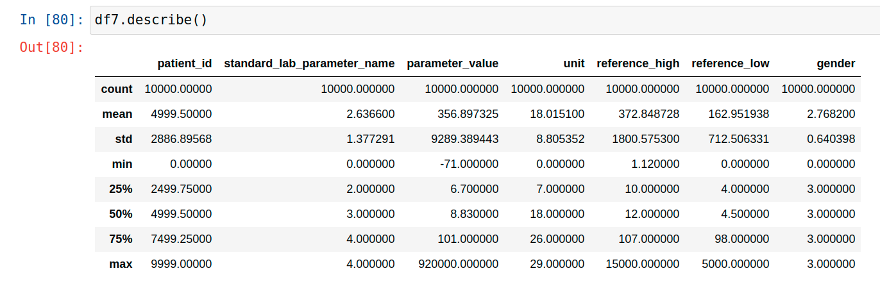
Exploratory Data Analysis
Generate descriptive statistics of Training Data

Slide 3
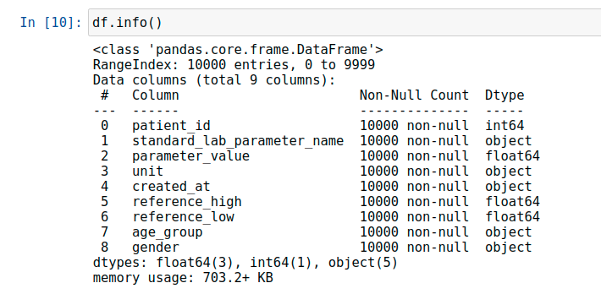
Descriptive analysis about non-null values and data-type

Slide 4
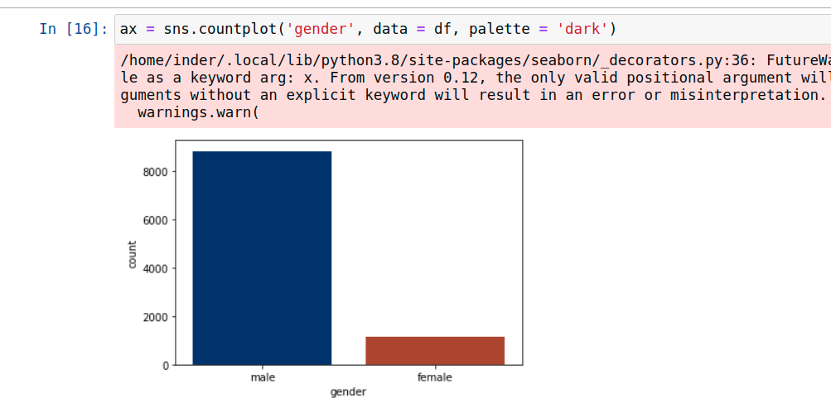
Histogram representing the Gender Count in Training Data

Slide 5
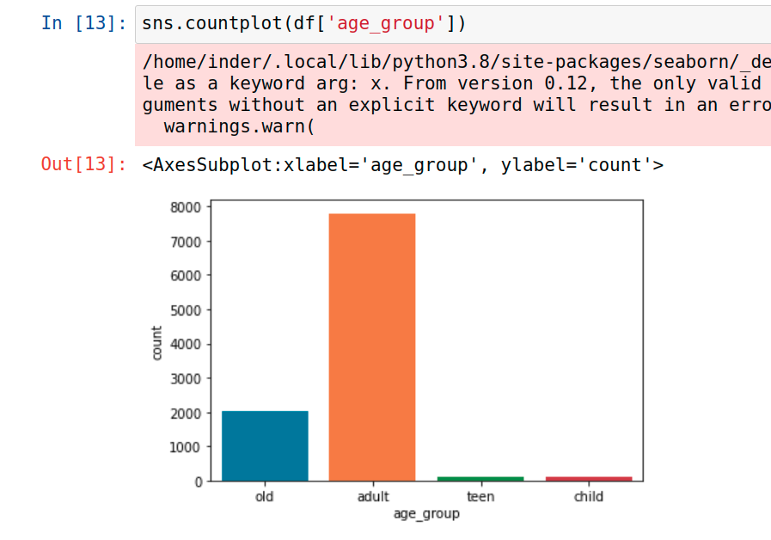
Histogram representing the different Age Group in Training Data

Slide 6
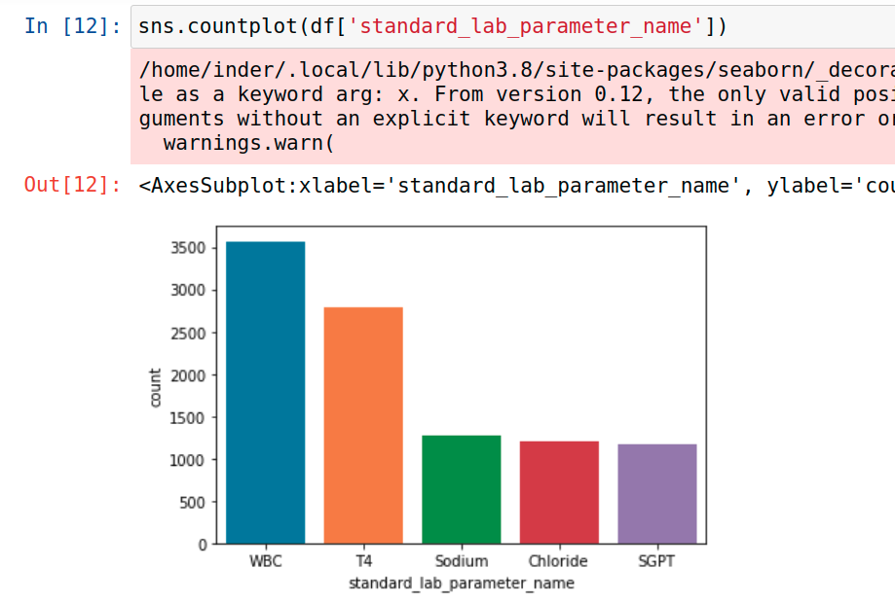
Histogram representing the different Lab parameters in Training Data

Slide 7
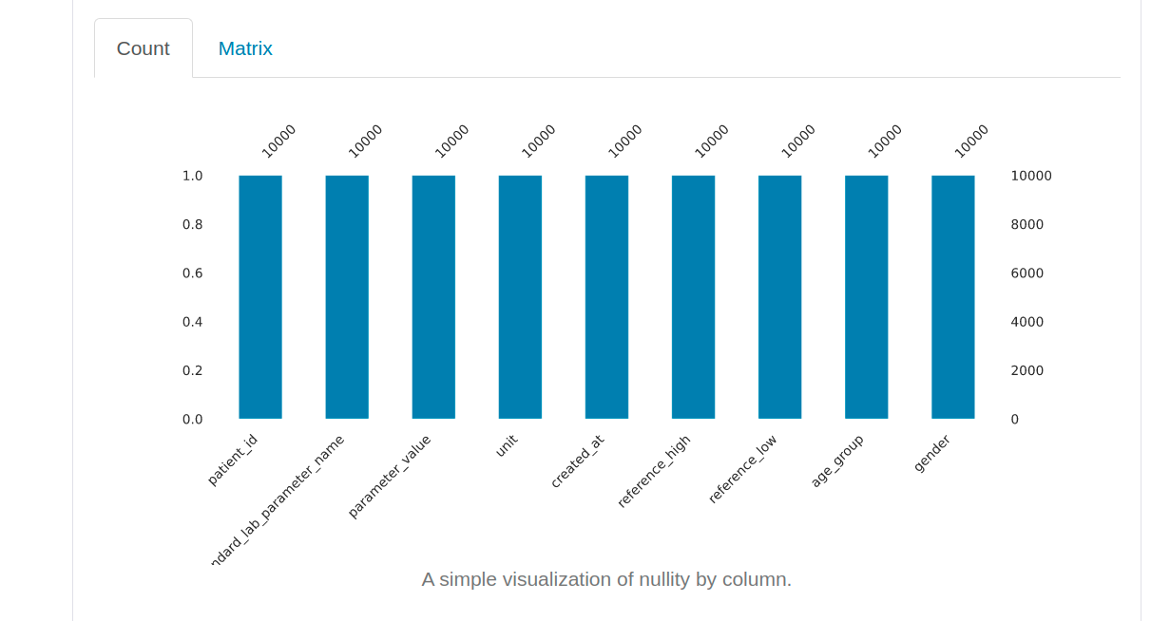
Plot showing column-wise null values count

Slide 8
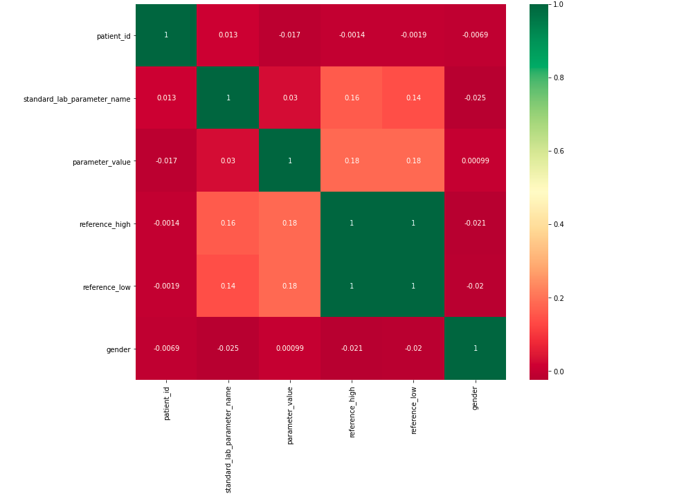
Correlation Matrix for Training Data

Slide 9
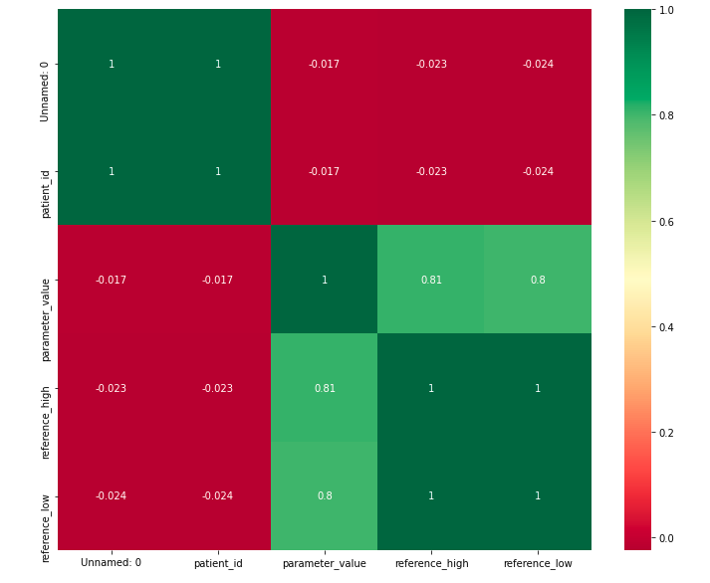
Correlation Matrix for Testing Data

Slide 10
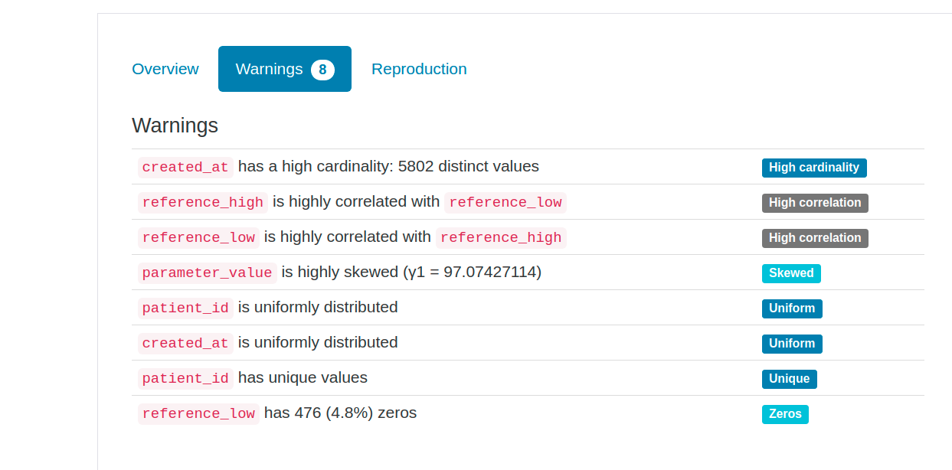
Insights about Training Data

Slide 11
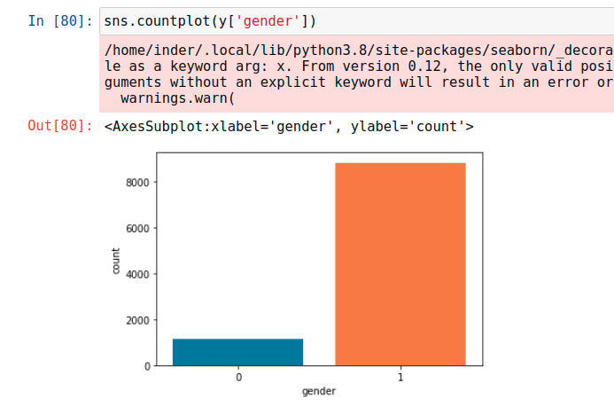
Histogram showing Gender-wise count in Training Data

Slide 12
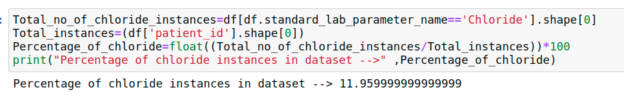
Chloride Comparison for different age_group for Training as well as Testing

Slide 13
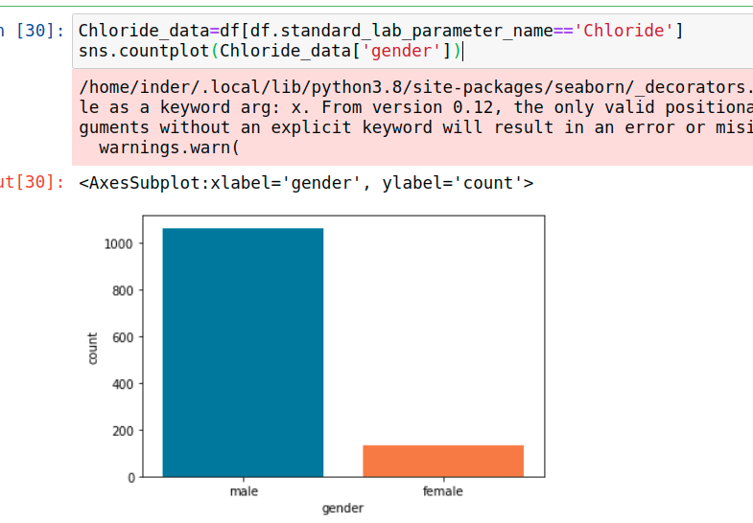
Histogram representing the Gender distribution with lab parameter=Chloride

Slide 14
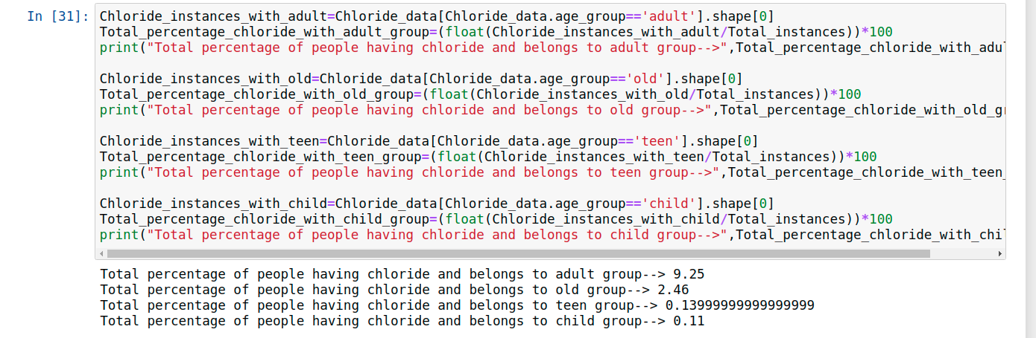
Distribution of Chloride among different Age Group

Slide 15
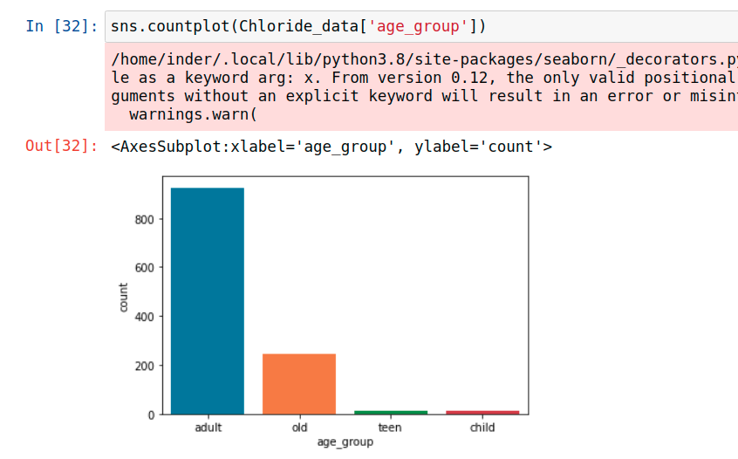
Histogram representing the Age Group distribution with lab parameter=Chloride

Slide 16
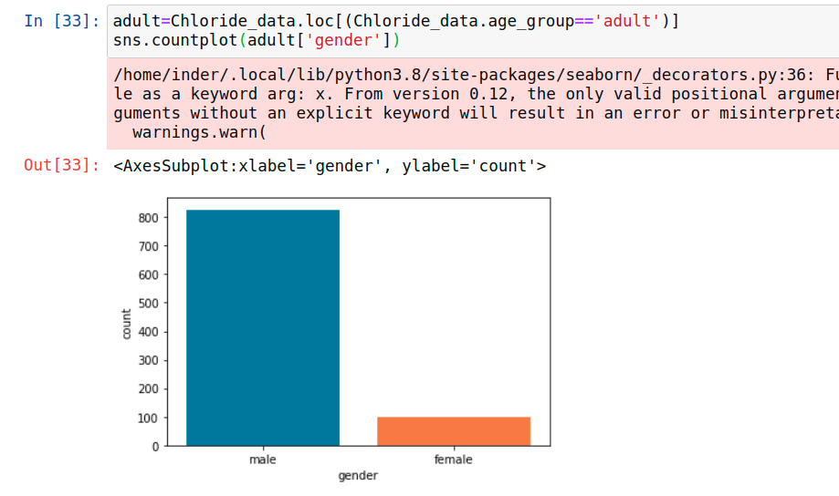
Histogram representing the Adult Age Group distribution with lab parameter=Chloride

Slide 17
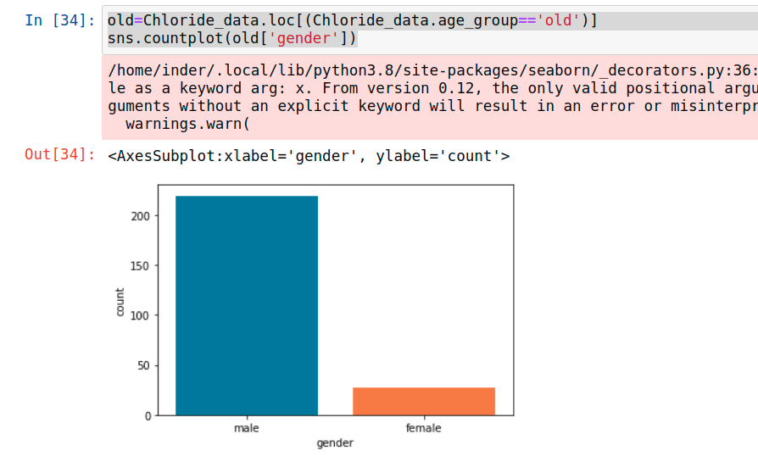
Histogram representing the Old Age Group distribution with lab parameter=Chloride

Slide 18
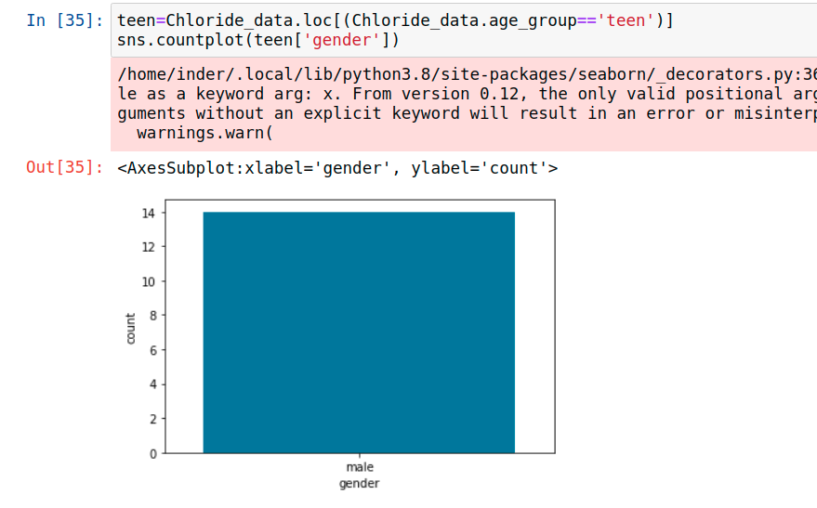
Histogram representing the Teen Age Group distribution with lab parameter=Chloride

Slide 19
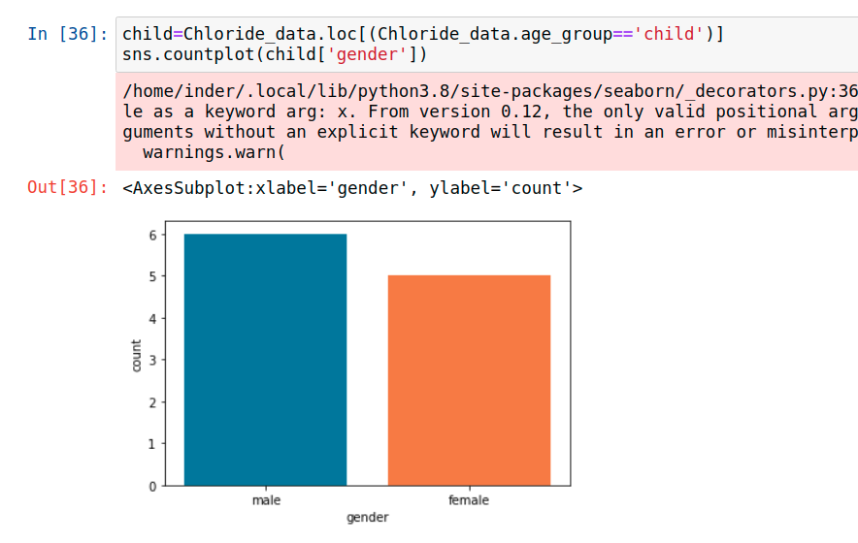
Histogram representing the Child Age Group distribution with lab parameter=Chloride

Slide 20
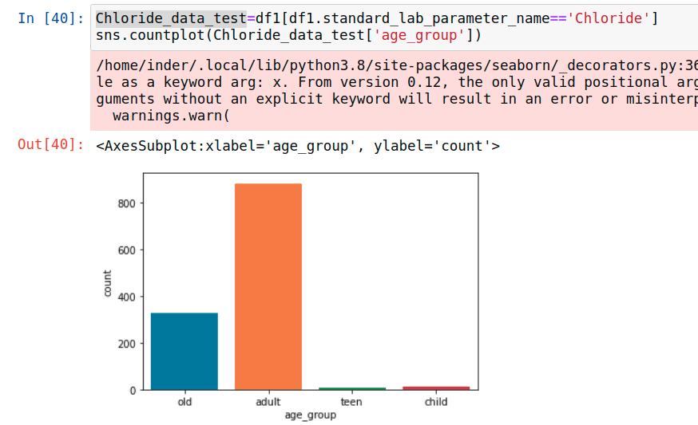
Histogram representing the Lab parameter=Chloride in Testing Data

Slide 21
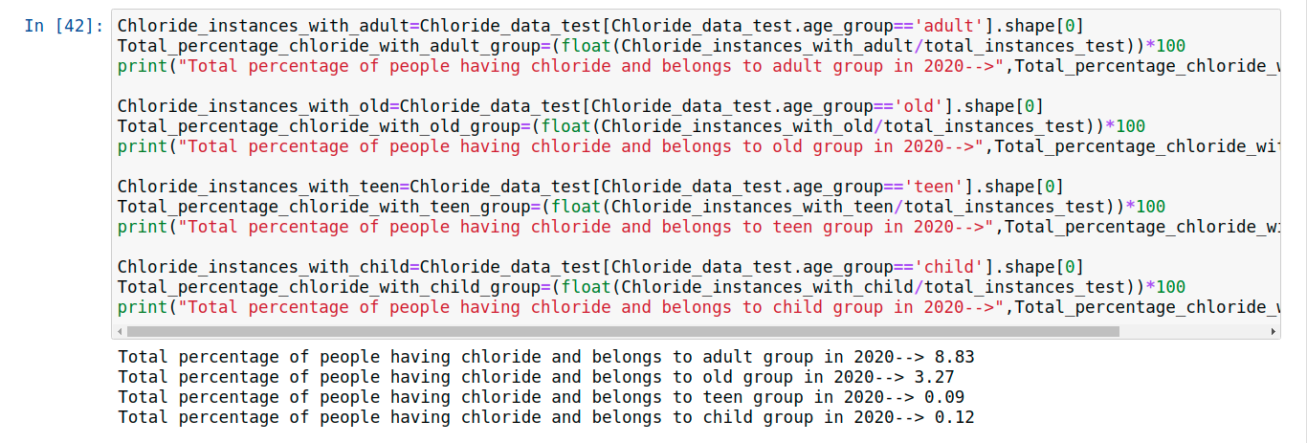
Percentage Wise Distribution of Chloride among different Age Group in Testing Data

Slide 22
Classifier for Gender Feature
Since the data for classification is imbalance having more than 80% instances of Male in the gender feature and less than 15 instances of Female.
For classification irrelevant columns such as unit,patient_id and created_at needs to be removed.
Features having high correlation should be dropped.
Since the data is imbalanced we can either undersample the data or oversample the data so that our model gets less robust and prevents from overfitting.
Near-Miss algorithm can be used to balance the imbalance dataset.
Random-Forest have been used for classification with maximum-depth of 4.
A Training Accuracy of 1 have been achieved.

Slide 23
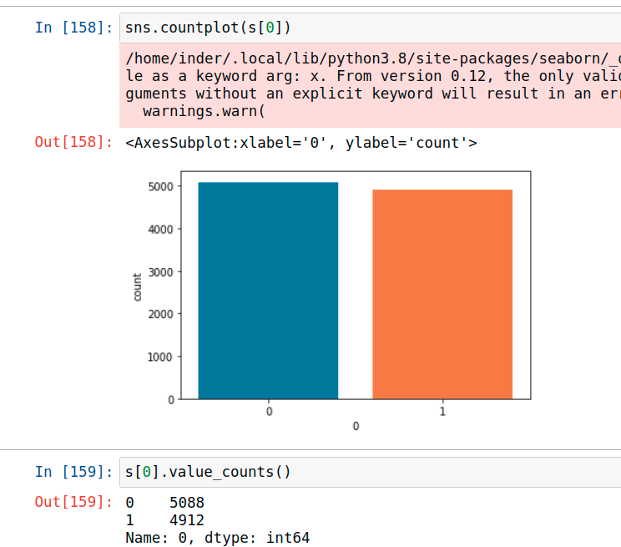
0:Female
1:Male
Results showing gender classification on Testing Data

Slide 24
Interesting Facts about the Dataset
There is no missing value in the training as well as testing data.
The features reference_high and reference_low are highly correlated with each other.
The parameter value is highly skewed with Gamma=97.07
The dataset is highly imbalanced on the gender feature with 80% instances belonging to the gender male.
The gender feature column is absent for the testing data.
The dataset have the data for the Patients belonging to different age groups and different gender with different lab parameters such as T4,Chloride,Sodium,WBC and SGPT.
The lab parameters have a lot of different units to calculate these parameters.

Slide 25
Practical Application about the Dataset
As the lab parameters include T4,Chloride,Sodium,WBC and SGPT .
The SGPT data can measure the amount of Glutamate Pyruvate Transaminase (GPT) in blood serum.
The Chloride data will help in measuring the blood volume,blood pressure and pH of the body fluids.
The Sodium data will help in measuring the abnormal sodium level including hyponatremia and hypernatremia.
The T4 data will help in evaluating the thyroid diseases, including hyperthyroidism and hypothyroidism in the body.
The WBC data can be used as part of diagnosing an infection or inflammatory diseases that affect the number of WBCs.

